Slide 1







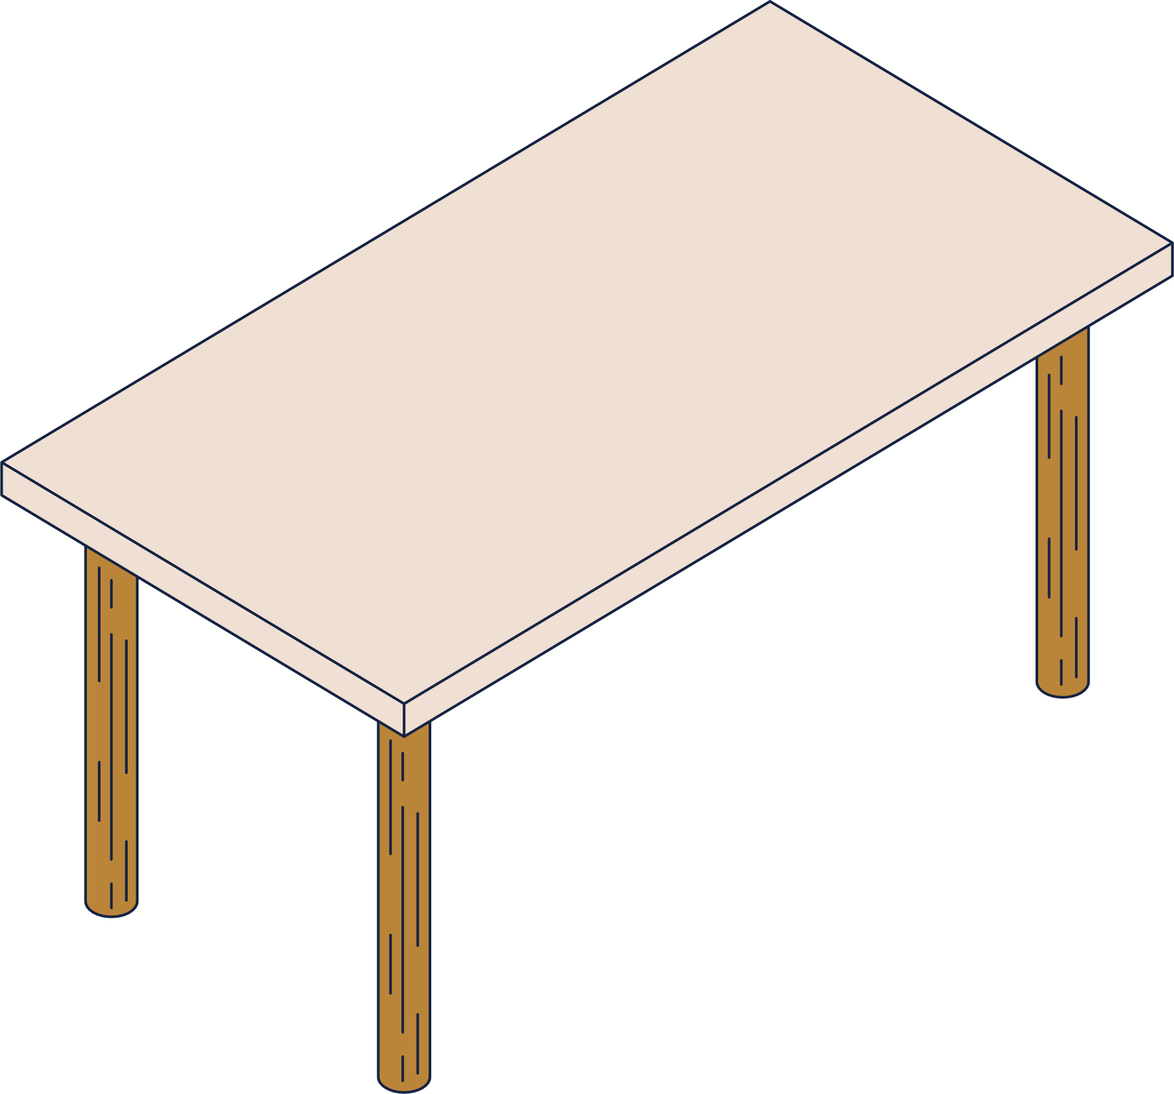
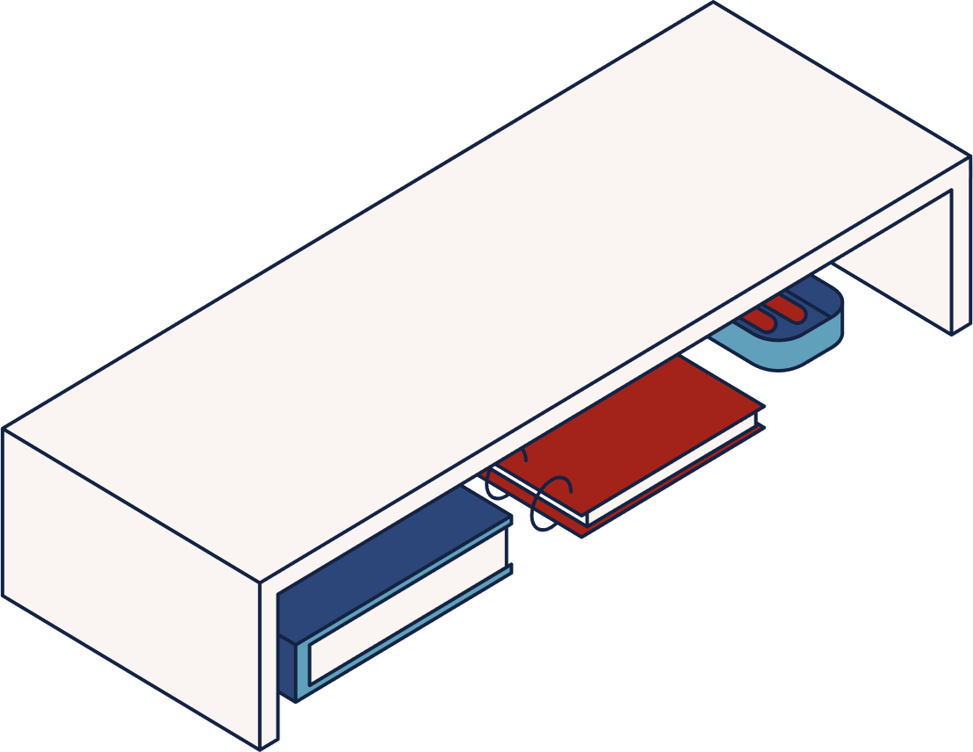






weather forecast
website
Mubara Naz 21CS030
Murk Mallah 21CS032
Manahil Shaikh 21CS064

Slide 2

Problem Statement:
In today's fast-paced world, accessing accurate and up-to-date weather information is essential for planning daily activities, travel, and events. However, users often struggle to find a simple and intuitive platform that provides real-time weather updates tailored to their location. Many weather platforms either present overwhelming data or lack essential information, making it difficult for users to make informed decisions. Moreover, users seek a visually appealing interface that adapts to weather changes, providing an enhanced user experience.

Slide 3


Objectives
1
2
3
To provide users with accurate, real-time weather updates for any city they search for.
To offer a simple, clean, and responsive interface.
To demonstrate the practical application of using APIs in web development.

Slide 4
HTML Structure
The HTML file defines the basic structure of the webpage.
It includes links to CSS and JavaScript files, and elements like a search bar and weather display.
Key elements include a div for the search bar, an input field for city search, and sections for displaying the city, temperature, weather icon, description, humidity, and wind speed.

Slide 5
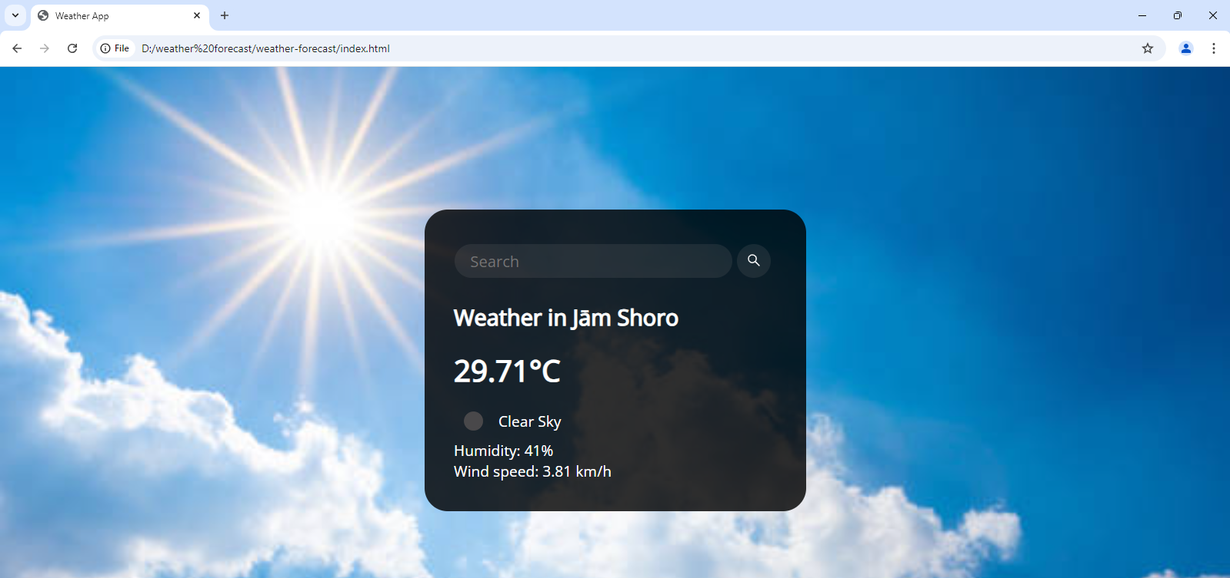
Default screen

Slide 6

html STRUCTURE
JavaScript Link:
Links script.js to add interactivity to the app, with the defer attribute to load the
script after HTML is fully parsed.
Font and CSS Links:
Links to the Google Fonts API to load the Open Sans font, providing a modern
and clean look.
Links style.css for external styling.
2. <body> Section
Card Container:
A <div class="card"> container wraps the entire app’s main content, giving
it a card-style layout.
Search Section:
Input and Button:
<input> field with class search-bar allows users to enter a city name.
<button> with an SVG (search icon) triggers the search functionality when clicked.
1 <head> Section

Slide 7

Weather Display Section:
<div class="weather loading"> holds all the weather details. The class loading can be used in CSS or JavaScript to show a loading animation while data is fetched.
City and Temperature:
<h2 class="city"> shows the location (default text: “Weather in Denver”).
<h1 class="temp"> displays the temperature (default text: 51°C).
Weather Icon and Description:
<img class="icon"> displays a weather icon (linked to OpenWeather icons).
<div class="description"> shows a brief description of the weather (default: “Cloudy”).
Humidity and Wind Information:
<div class="humidity"> and <div class="wind"> display additional details like humidity and wind speed.

Slide 8

CSS Styling
The CSS file is used to style the webpage.
It defines layout properties like flexbox to center the content, background images, button styling, and text formatting.
We also use media queries to ensure the page is responsive and looks good on different devices.

Slide 9
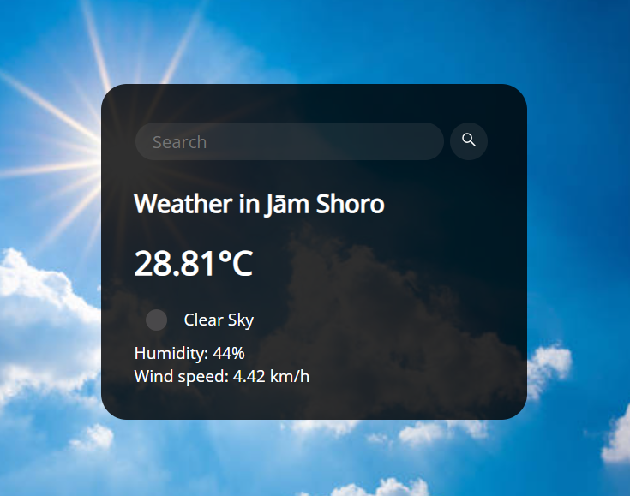
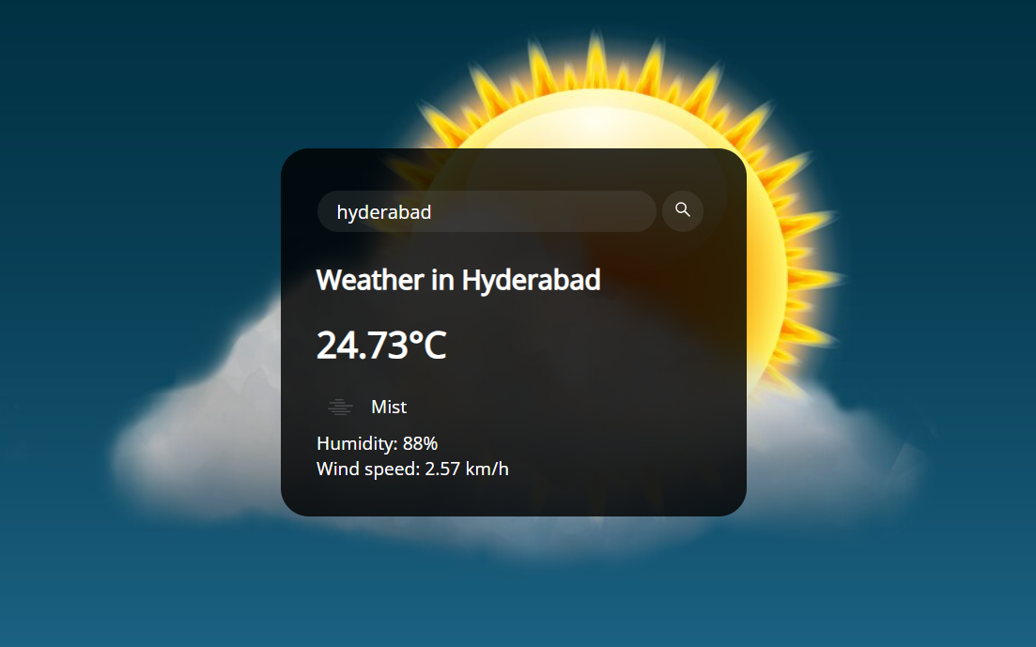

Flexbox to center the content: .flex {
display: flex;
align-items: center;
}
Default background image: background-image: "default_weather.jpg";
background-repeat: no-repeat;
background-size: cover;
background-position: center;
Button styling: button {
margin: 0.5em;
border-radius: 50%;
border: none;
height: 44px; width: 44px;
outline: none;
background: #7c7c7c2b;
color: white; cursor: pointer;
transition: 0.2s ease-in-out;
}

Slide 10

what is an Api ?
An API (Application Programming Interface) is a set of rules and protocols that allows different software applications to communicate and interact with each other.
How APIs Work:
Request
Processing
Response
Output

Slide 11

JavaScript and API Integration
API Key: Used for authentication with the OpenWeatherMap.org
API Methods:
fetchWeather(city):
Fetches weather data for the given city.
Handles errors if no data is found.
displayWeather(data):
Displays city name, temperature, humidity, wind speed, and weather description.
Changes background image based on weather conditions (e.g., clear, rain, snow).
User Interaction:
Search button and Enter key trigger the search( ) method to fetch weather for the input city.
Example Call:
weather.fetchWeather("jamshoro"): Fetches and displays weather data for Jamshoro on load.

Slide 12
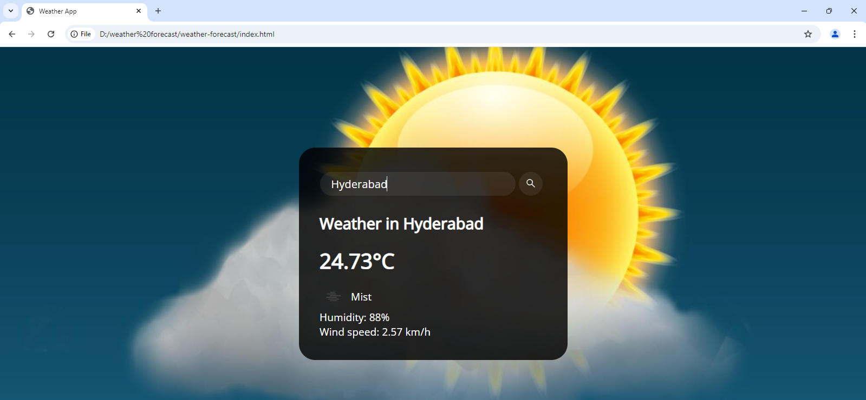
City Search Functionality

Slide 13




We have added different background images for different weather conditions such as:
For clear sky
For rainy
For cloudy
For Snow

Slide 14
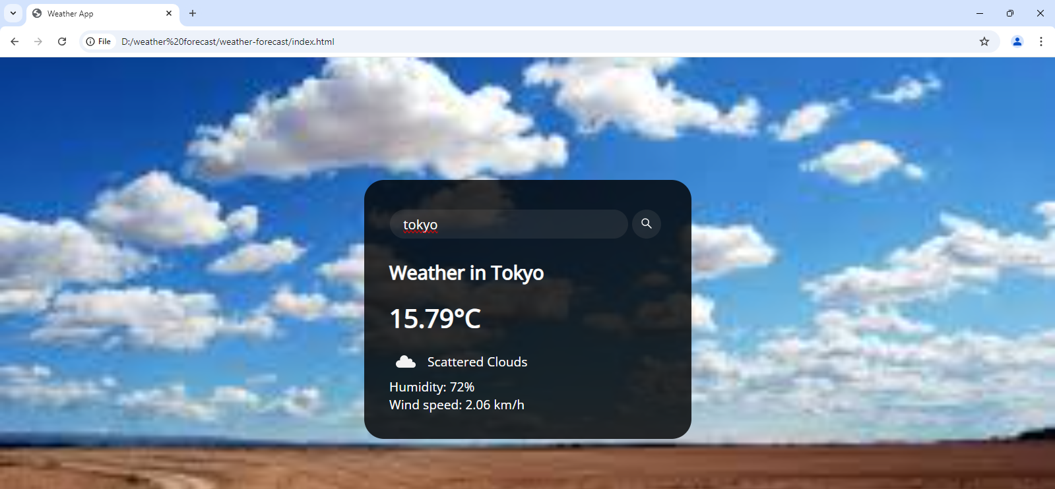
Dynamic backgrounds

Slide 15
Thank you for listening!

